Slide 1
Minor Project Progress Report On A Mini Operating System
By: Sanyam Jain

Slide 2
OBJECTIVE
To develop a mini operating system that will be a demonstrative implementation of Operating System using Low Level Language (C and Assembly).

Slide 3
TEAM MEMBERS
Sanyam Jain (CO2 Section)
Roll Number – 1512023
B.tech Final Year
Computer Science Department

Slide 4
Components Completed

Slide 5
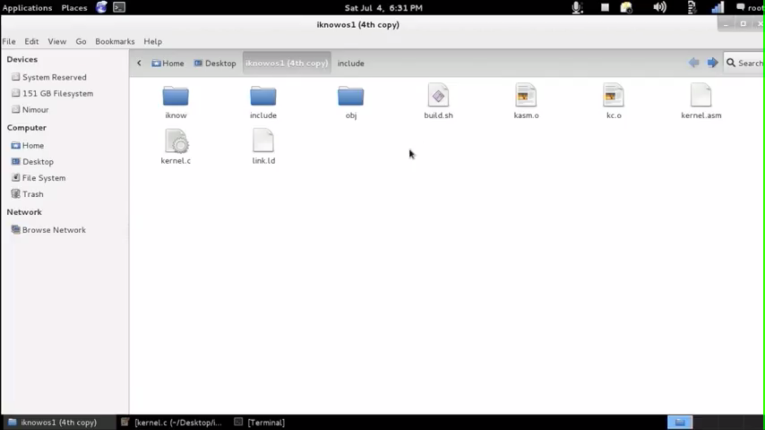
Directory Structure 1

Slide 6
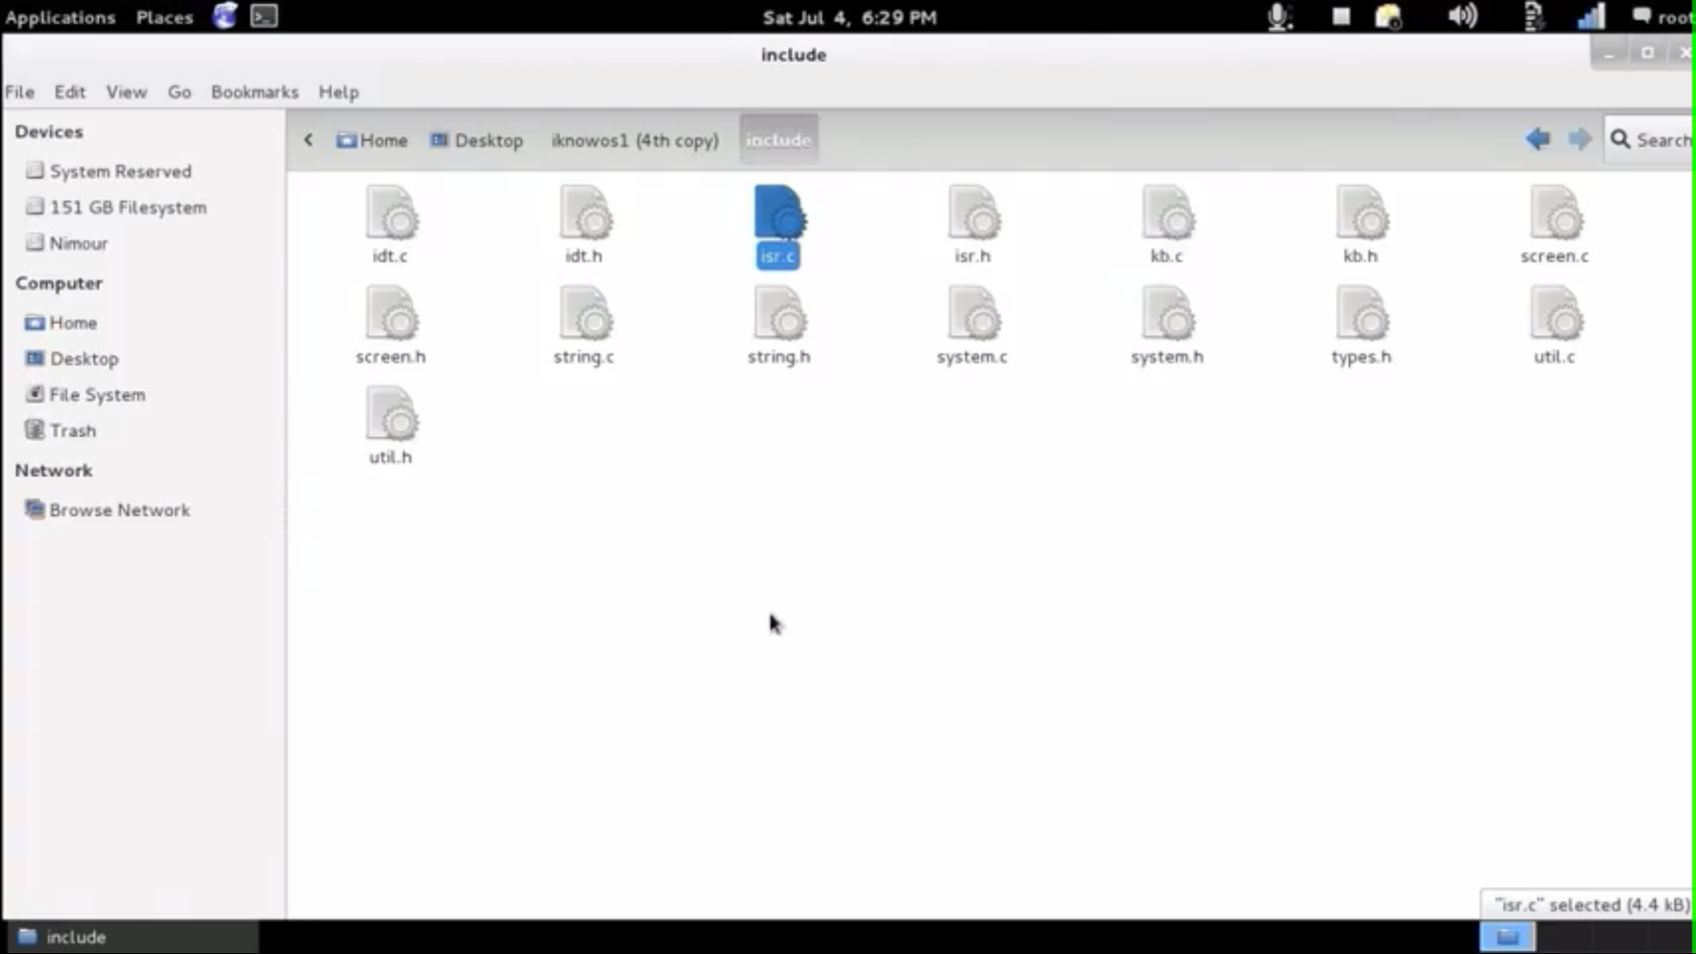
Directory Structure 2

Slide 7
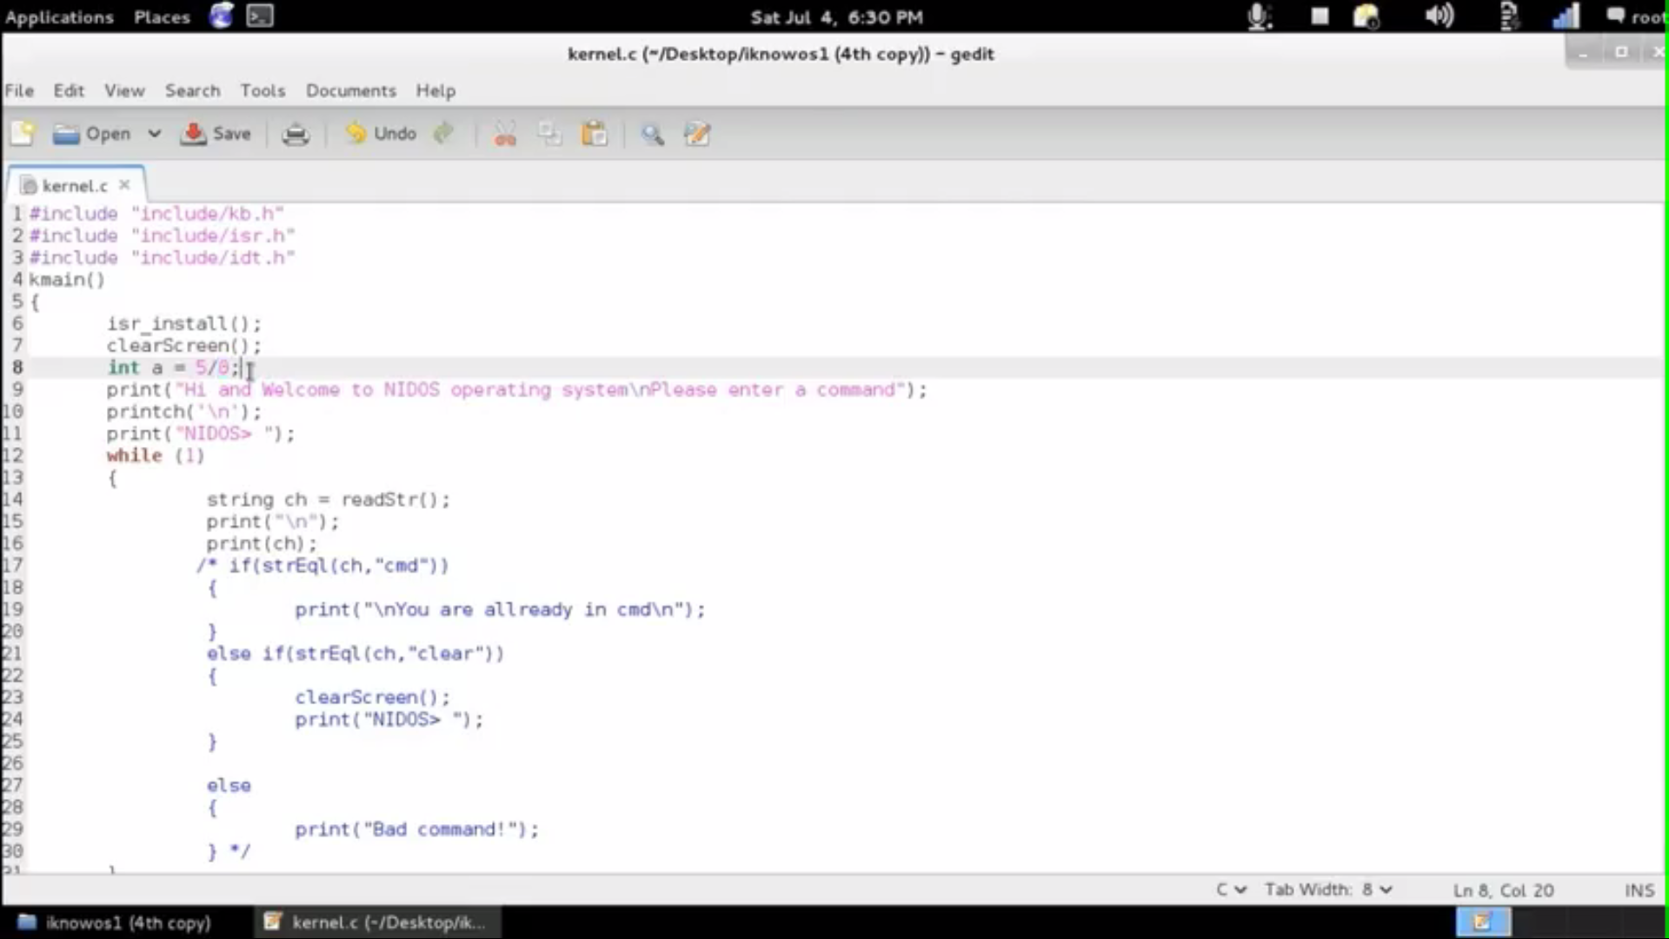
kernel.c

Slide 8
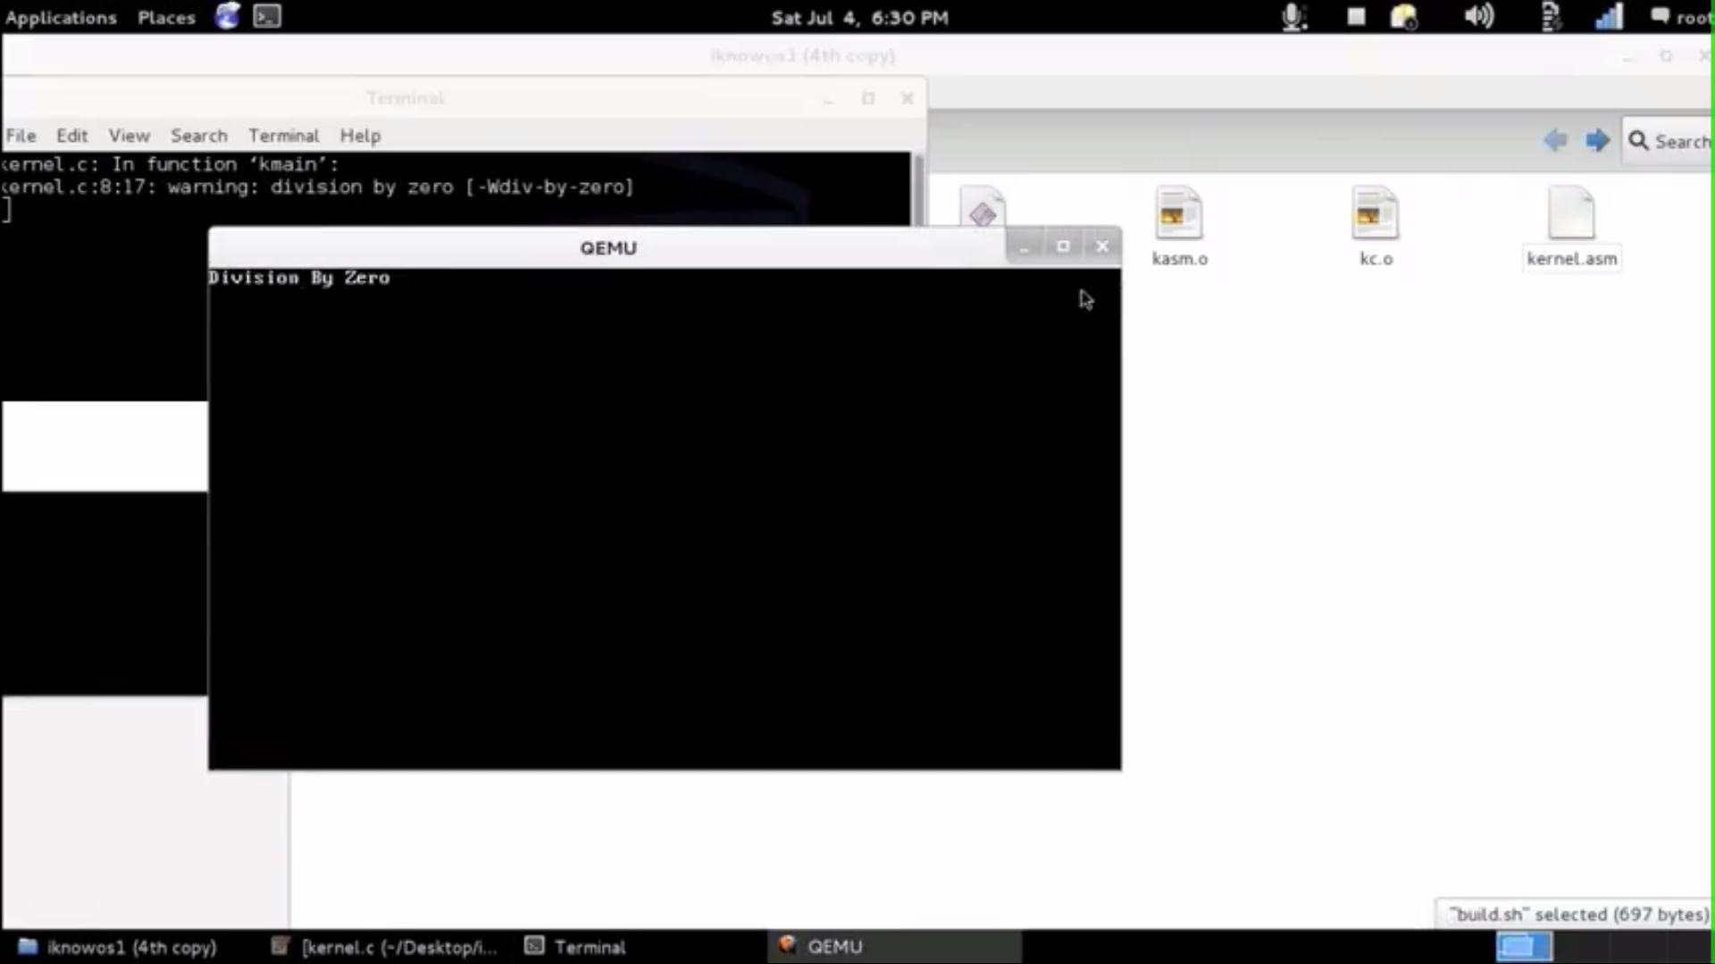
Division By Zero – Unit Testing

Slide 9
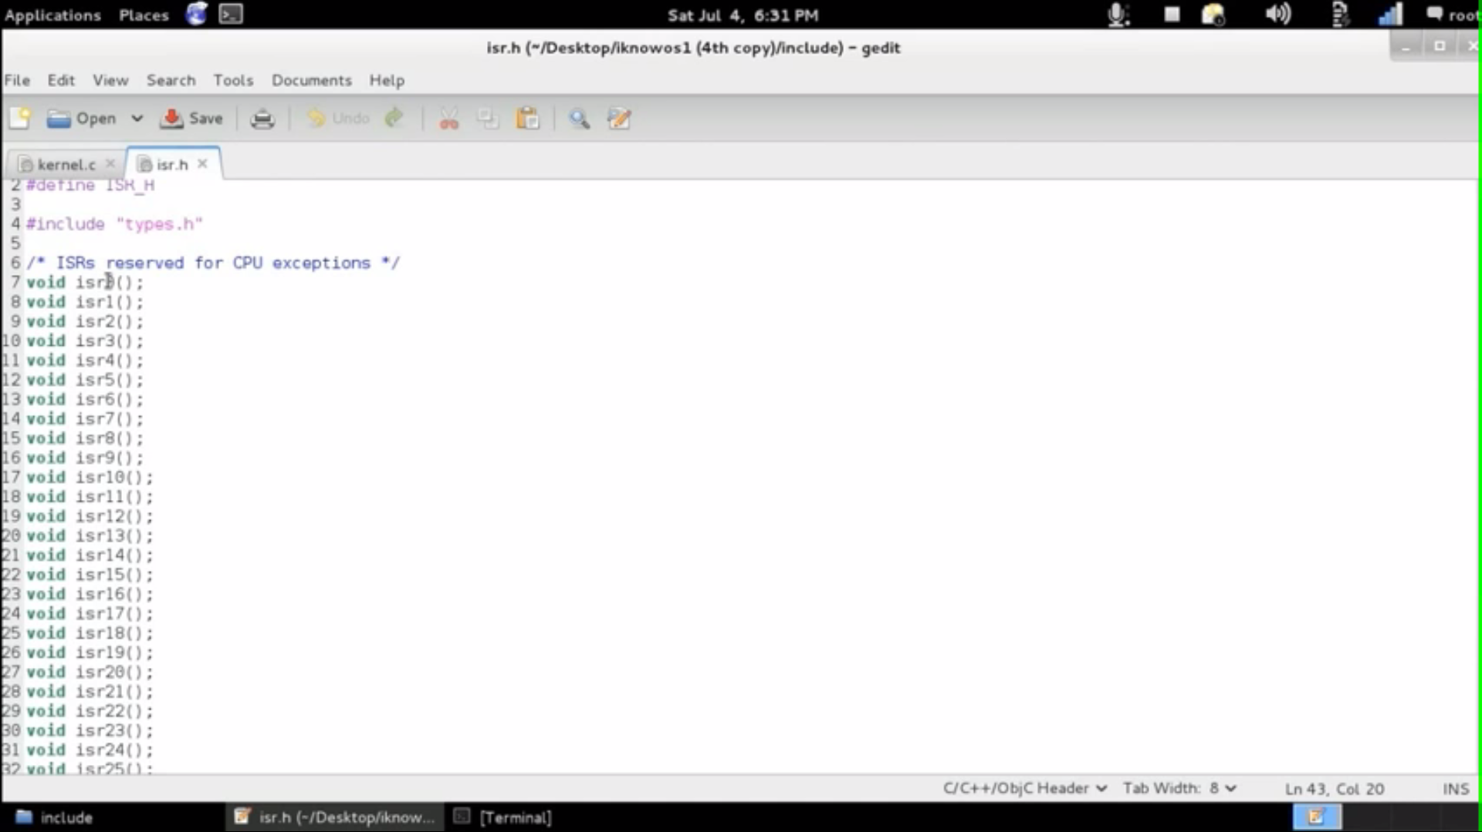
isr.h

Slide 10
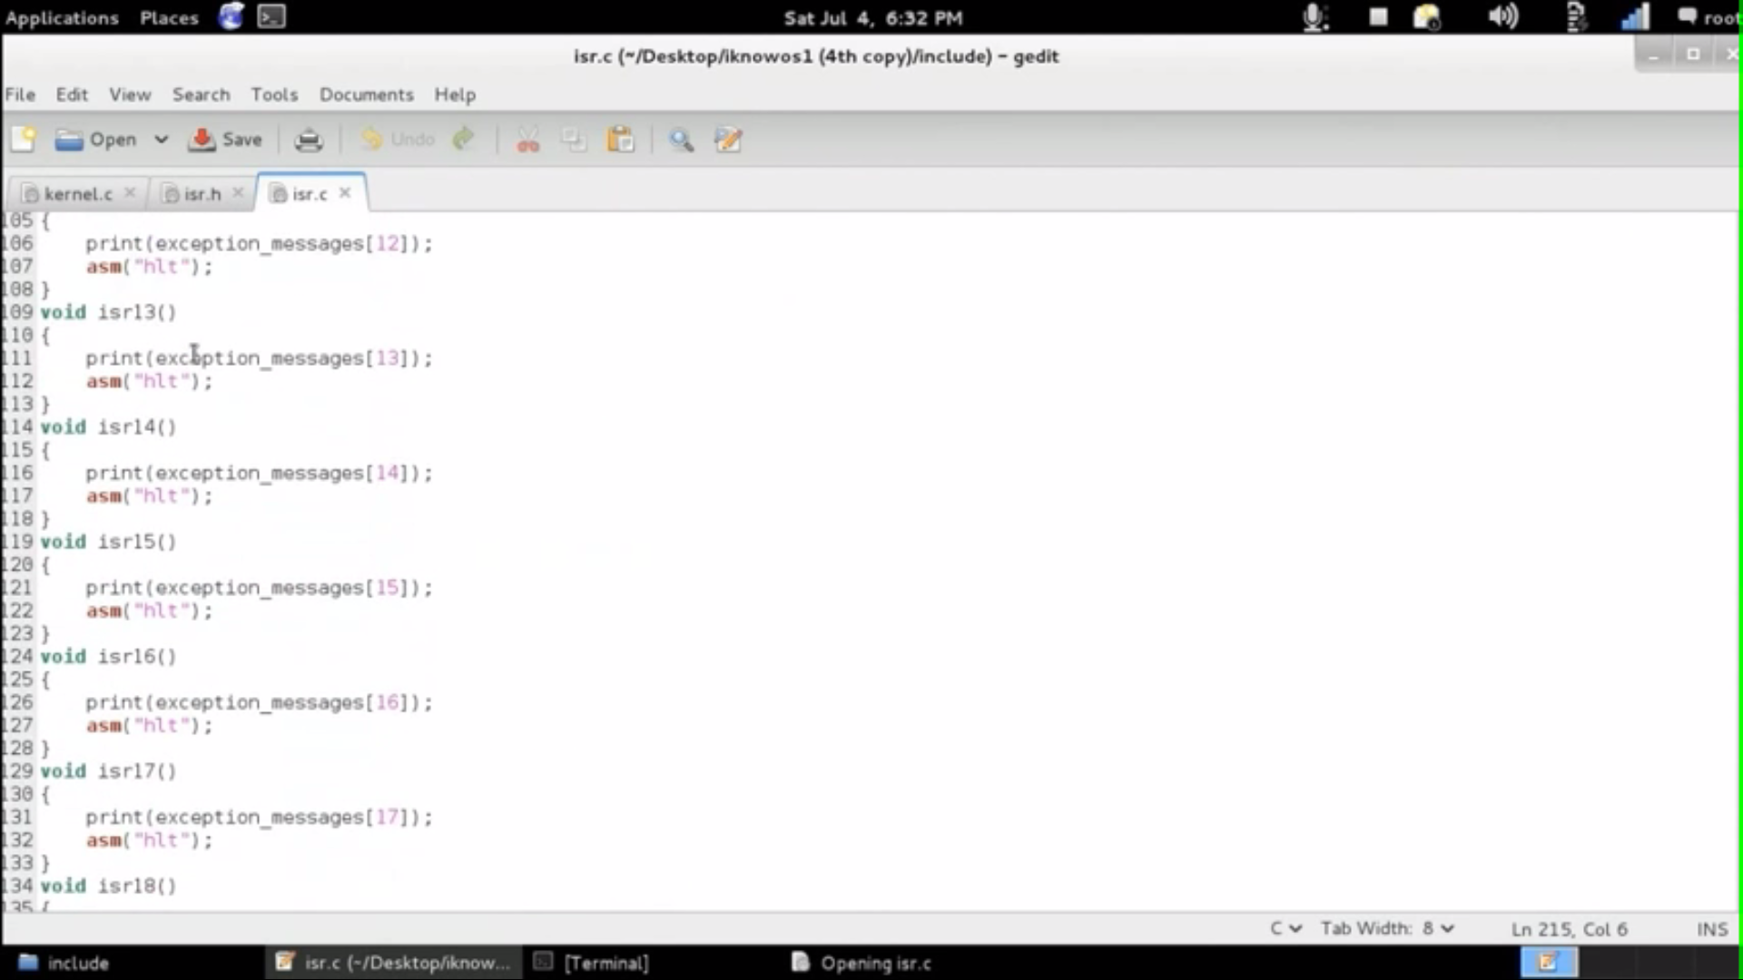
isr.c

Slide 11
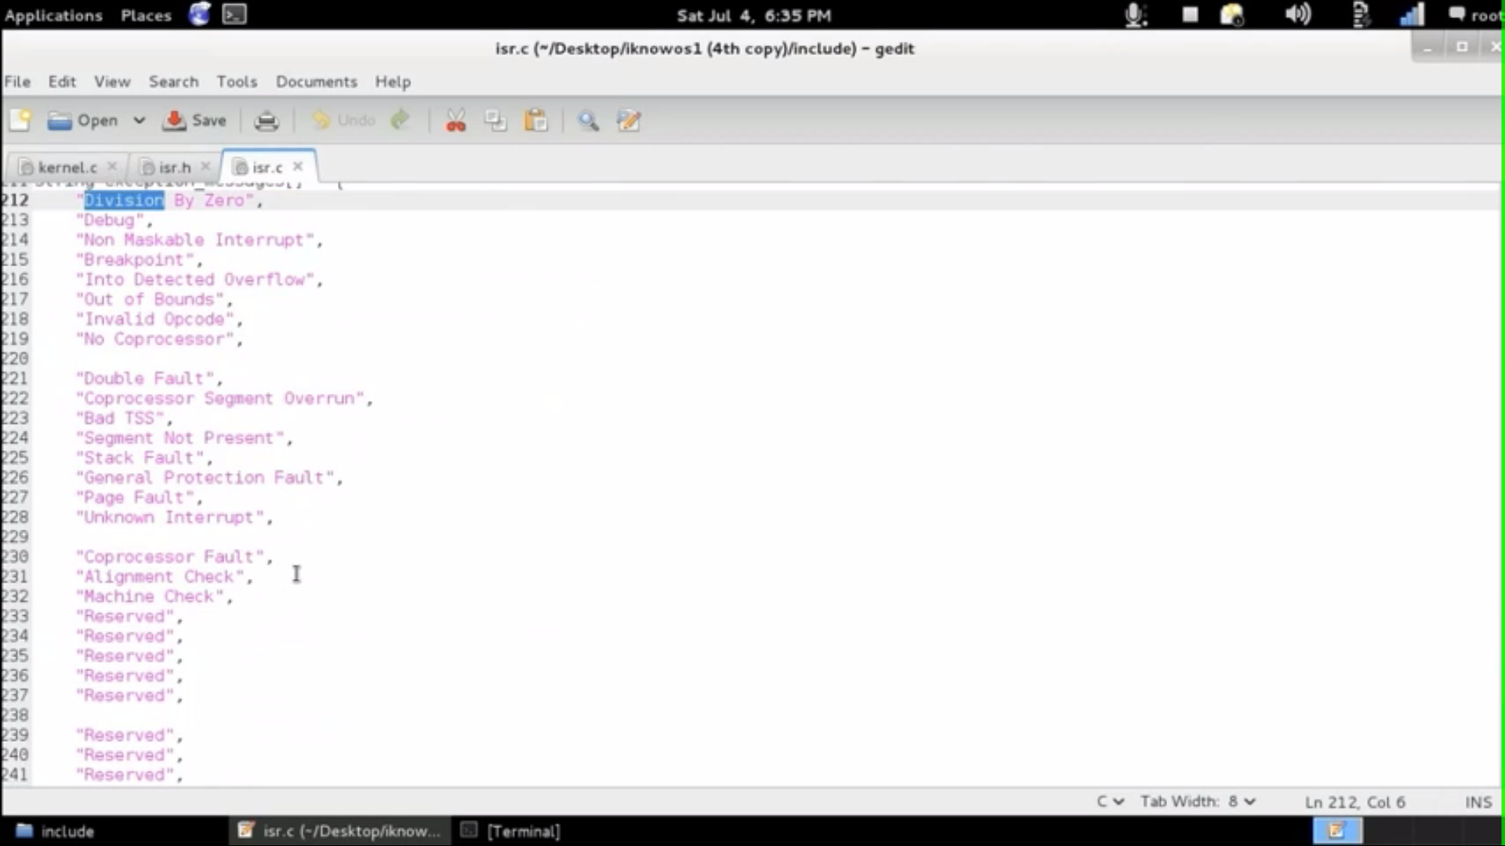
isr.c 2

Slide 12
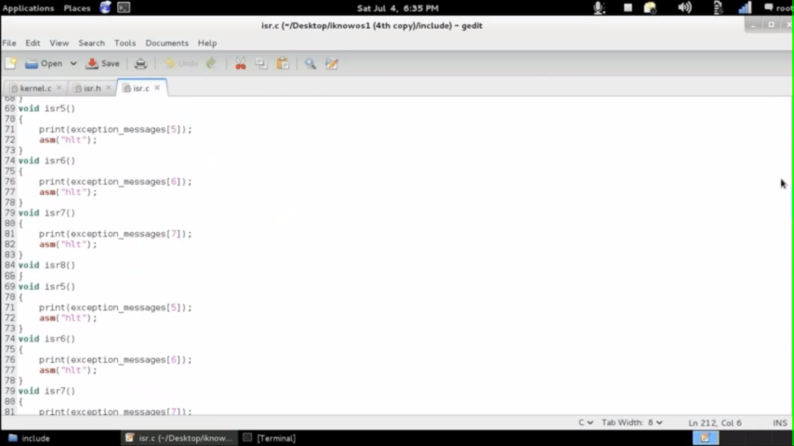
isr.c 3

Slide 13
Components Under Progress
The Collective integration of all the components.
System Testing of the Project.

Slide 14
Thank You.

